Slide 1

Clap to Light
(CES Lab)
Presented by: Muhammad Sarosh Ali
S Asher Jawaid

Slide 2
Scope of the project
Should turns on a LEDs depending on a clapped rhythm using an Arduino.
Should takes claps as an input.
The module should play back the rhythm after it stores it(on a press of button).
Should store up to three rhythms.
The system identifies and turn on a LED if it is pre-stored.
Should store the rhythms and loads them after reset/power off.

Slide 3
Design Approach(Hardware)
LEDs connected in series with the resistors to separate I/O pins.
Push buttons connected in series with the resistors to separate I/O pins.
Sound sensor connected to analogue input pins.
Buzzer connected to I/O pins.

Slide 4
Design Approach(Software)
Listens for a sound on Power On.
Creates a empty data structure to store claps as input(stores upto 8 claps).
Can be programmed for three distinct rhythms.
Compares sensor threshold with clap sound and adds it in an array.
A button can be used to save the rhythms on the EEPROM.

Slide 5
Design Approach(Software)(continued)
Triggers a LED to confirm data is stored.
Loads rhythm from EEPROM when powered on.
Plays back buzzer once the play button is pressed on the board.

Slide 6
Application
Differentiate between different claps.
Save the claps to corresponding LEDs.
Save the claps in EEPROM so that that data is preserved even when the arduino is powered off.
Loads data from EEPROM when the system is reset/powered on.

Slide 7
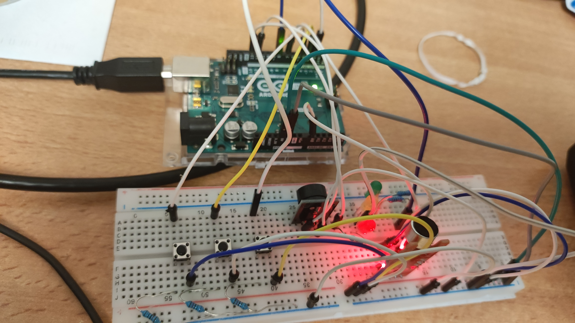
Demo

Slide 8
Problems Faced and its Solution
Saving the rhythms in the main memory so that the data is retrieved even when the device(Arduino) is reset.
The problem was solved using EEPROM(non-volatile) storage system and loading it as soon as the Arduino is reset/powered on.
Using minimum buttons to produce maximum operations.
The issue was tackled by using a button as a toggle, as well as loading the data from EEPROM in setup phase.

Slide 9
Thank You!

